Slide 1
Chapter 3 Algorithms
Section 3.2 :Growth of Functions

Slide 2
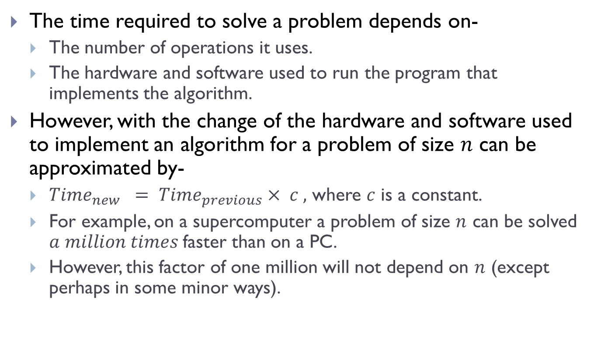
Introduction
The time required to solve a problem depends on-
The number of operations it uses.
The hardware and software used to run the program that implements the algorithm.
However, with the change of the hardware and software used to implement an algorithm for a problem of size $n$ can be approximated by-
$Time_{new} = Time_{previous}× c ,$ where $c$ is a constant.
For example, on a supercomputer a problem of size $n$ can be solved $a million times$faster than on a PC.
However, this factor of one million will not depend on $n$ (except perhaps in some minor ways).

Slide 3
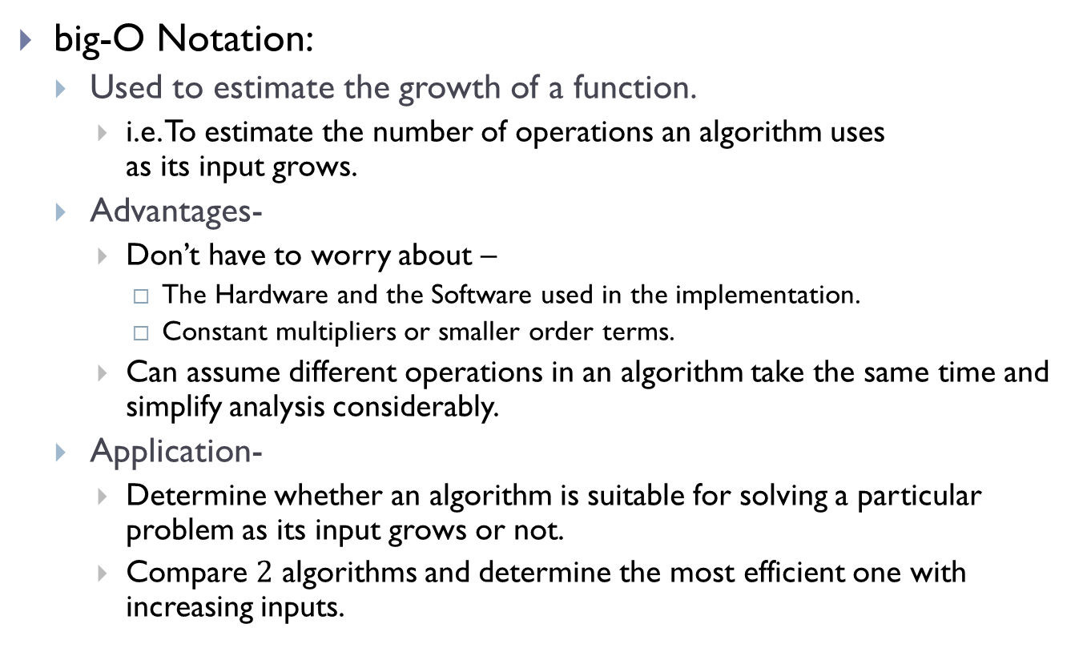
big-O Notation
big-O Notation:
Used to estimate the growth of a function.
i.e. To estimate the number of operations an algorithm uses as its input grows.
Advantages-
Don’t have to worry about –
The Hardware and the Software used in the implementation.
Constant multipliers or smaller order terms.
Can assume different operations in an algorithm take the same time and simplify analysis considerably.
Application-
Determine whether an algorithm is suitable for solving a particular problem as its input grows or not.
Compare $2$ algorithms and determine the most efficient one with increasing inputs.

Slide 4
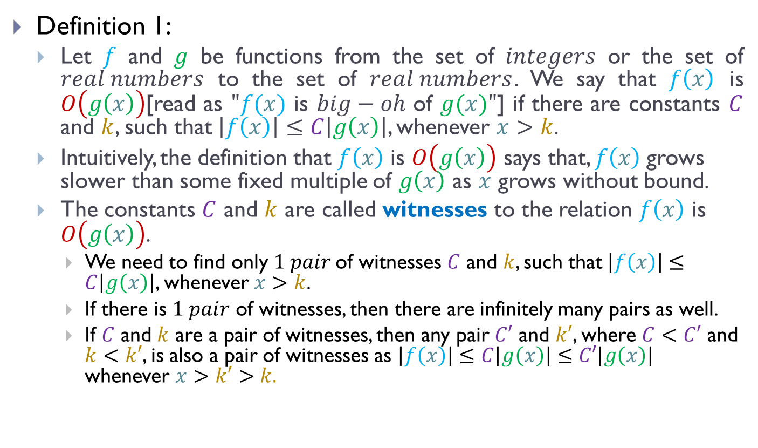
big-O Notation (Contd.)
Definition 1:
Let $f$ and $g$ be functions from the set of $integers$ or the set of $real numbers$ to the set of $real numbers$. We say that $f\left(x\right)$ is $O\left(g\left(x\right)\right)$[read as $"f(x)$ is $big−oh$ of $g(x)"$] if there are constants $C$ and $k$, such that$\left|f\left(x\right)\right|≤C\left|g\left(x\right)\right|$, whenever $x>k$.
Intuitively, the definition that $f\left(x\right)$ is $O\left(g\left(x\right)\right)$ says that, $f\left(x\right)$grows slower than some fixed multiple of $g\left(x\right)$ as $x$ grows without bound.
The constants $C$ and $k$ are called witnesses to the relation $f\left(x\right)$ is $O\left(g\left(x\right)\right)$.
We need to find only $1 pair$of witnesses $C$ and $k$, such that$\left|f\left(x\right)\right|≤C\left|g\left(x\right)\right|$, whenever $x>k$.
If there is $1 pair$ of witnesses, then there are infinitely many pairs as well.
If $C$ and $k$ are a pair of witnesses, then any pair $C′$ and $k′$, where $C<C′$ and $k<k′$, is also a pair of witnesses as $\left|f\left(x\right)\right|≤C\left|g\left(x\right)\right|$ $≤C′\left|g\left(x\right)\right|$ whenever $x>k′>k.$

Slide 5

big-O Notation (Contd.)
Finding witnesses-
Firstly, select a value of $k$ for which the size of $\left|f\left(x\right)\right|$ can be readily estimated when $x>k$.
Secondly, use this estimate to find a value of $C$ for which $|f (x)| ≤ C\left|g\left(x\right)\right|$for $x > k$.

Slide 6
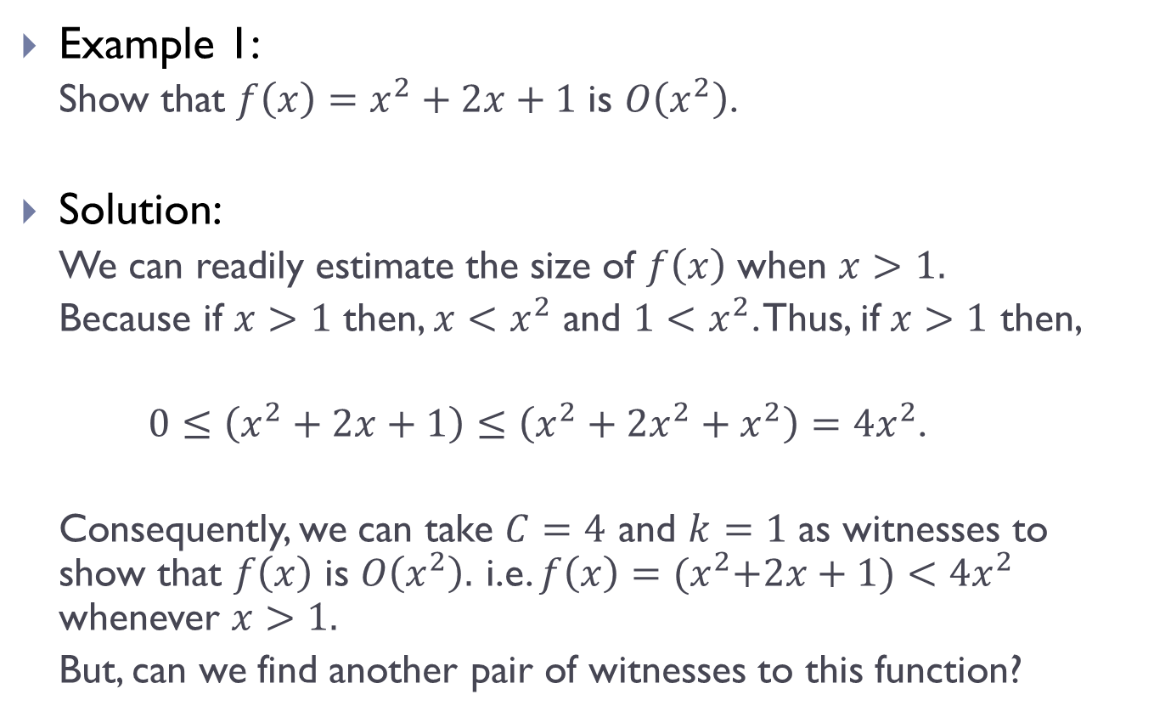
big-O Notation (Contd.)
Example 1:
Show that $f\left(x\right)=x^{2}+2x+1$ is $O\left(x^{2}\right)$.
Solution:
We can readily estimate the size of $f\left(x\right)$ when $x>1.$
Because if $x>1$ then, $x<x^{2}$ and $1<x^{2}$. Thus, if $x>1$ then,
$0≤\left(x^{2}+2x+1\right)≤\left(x^{2}+2x^{2}+x^{2}\right)=4x^{2}$.
Consequently, we can take $C=4$ and $k=1$ as witnesses to show that $f\left(x\right)$ is $O\left(x^{2}\right).$ i.e. $f\left(x\right)={(x}^{2}+2x+1)<4x^{2}$ whenever $x>1.$
But, can we find another pair of witnesses to this function?

Slide 7
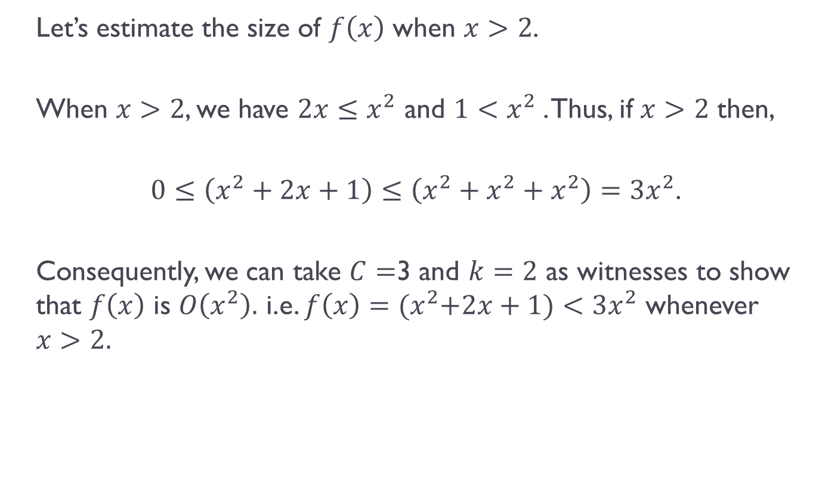
big-O Notation (Contd.)
Let’s estimate the size of $f\left(x\right)$ when $x>2$.
When $x>2$, we have $2x≤x^{2}$ and $1<x^{2}$. Thus, if $x>2$ then,
$0≤\left(x^{2}+2x+1\right)≤\left(x^{2}+x^{2}+x^{2}\right)=3x^{2}$.
Consequently, we can take $C=$3 and $k=2$ as witnesses to show that $f\left(x\right)$ is $O\left(x^{2}\right).$ i.e. $f\left(x\right)={(x}^{2}+2x+1)<3x^{2}$ whenever $x>2.$

Slide 8
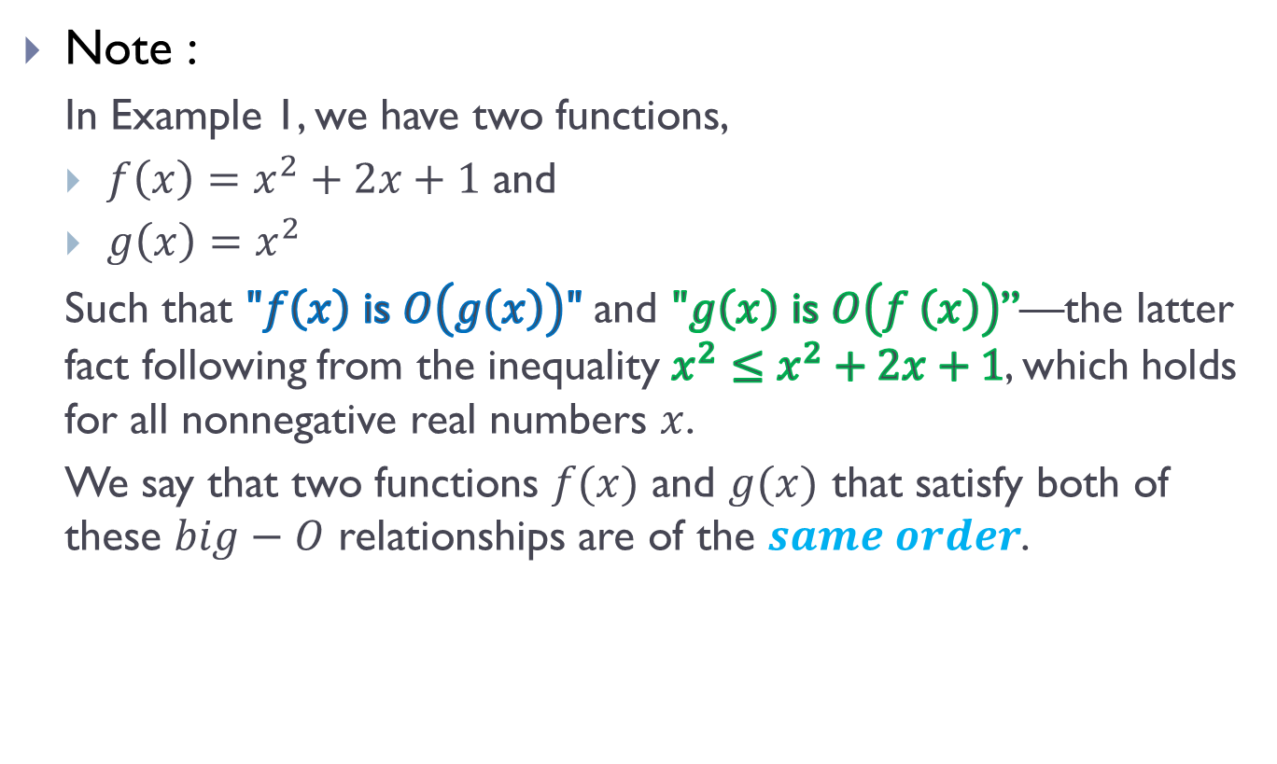
big-O Notation (Contd.)
Note :
In Example 1, we have two functions,
$f\left(x\right)=x^{2}+2x+1$ and
$g\left(x\right)=x^{2}$
Such that $"f\left(x\right)$ is $O\left(g\left(x\right)\right)"$ and $"g\left(x\right)$ is $O\left(f \left(x\right)\right)$”—the latter fact following from the inequality $x^{2}≤x^{2}+2x+1$, which holds for all nonnegative real numbers $x$.
We say that two functions $f(x)$ and $g(x)$ that satisfy both of these $big−O$ relationships are of the $same order$.

Slide 9
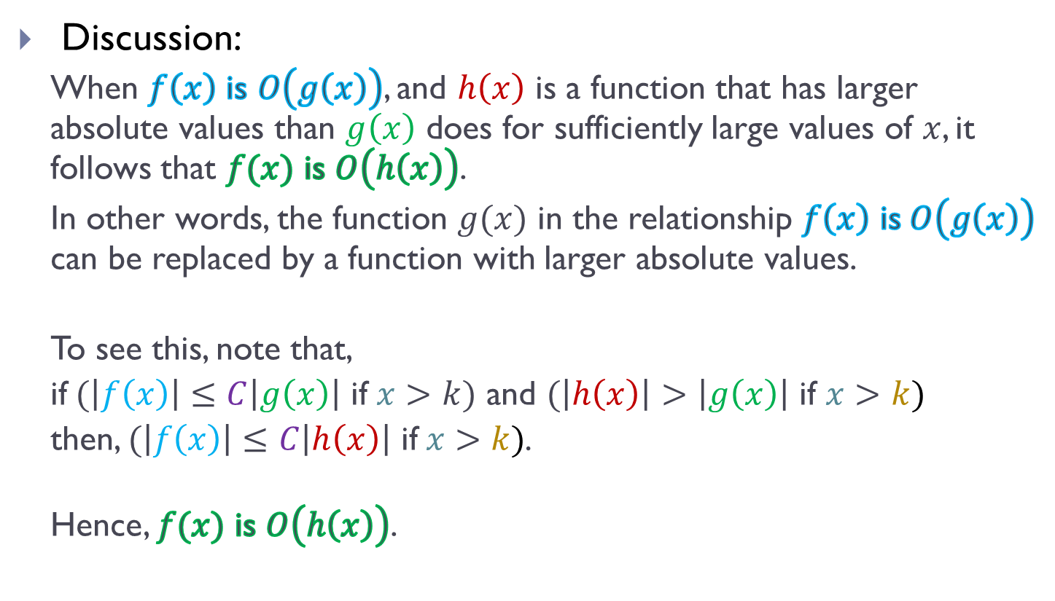
big-O Notation (Contd.)
Discussion:
When $f\left(x\right)$ is $O\left(g\left(x\right)\right)$, and $h\left(x\right)$ is a function that has larger absolute values than $g\left(x\right)$ does for sufficiently large values of $x$, it follows that $f(x)$ is $O\left(h\left(x\right)\right)$.
In other words, the function $g(x)$ in the relationship $f\left(x\right)$ is$O\left(g\left(x\right)\right)$ can be replaced by a function with larger absolute values.
To see this, note that,
if$(\left|f\left(x\right)\right|≤C\left|g\left(x\right)\right|$ if $x>k)$ and $(\left|h\left(x\right)\right|>\left|g\left(x\right)\right|$ if $x>k)$
then, $(\left|f\left(x\right)\right|≤C\left|h\left(x\right)\right|$ if$x>k)$.
Hence, $f(x)$ is $O\left(h\left(x\right)\right)$.

Slide 10
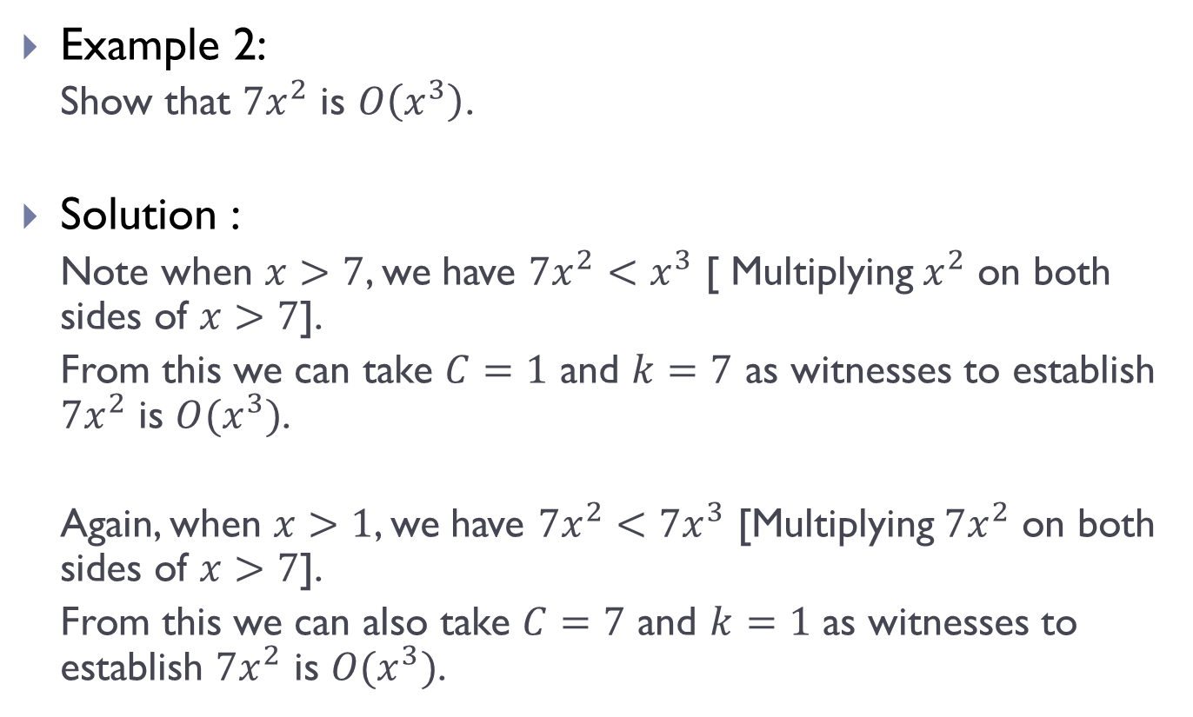
big-O Notation (Contd.)
Example 2:
Show that $7x^{2}$ is $O\left(x^{3}\right)$.
Solution :
Note when $x>7$, we have $7x^{2}<x^{3}$ [ Multiplying $x^{2}$ on both sides of $x>7$].
From this we can take $C=1$ and $k=7$ as witnesses to establish $7x^{2}$ is $O(x^{3})$.
Again, when $x>1$, we have $7x^{2}<7x^{3}$ [Multiplying $7x^{2}$ on both sides of $x>7$].
From this we can also take $C=7$ and $k=1$ as witnesses to establish $7x^{2}$ is $O(x^{3})$.

Slide 11
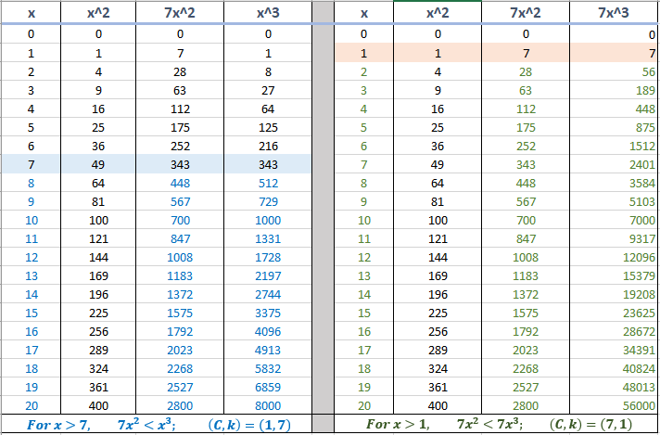
big-O Notation (Contd.)

Slide 12
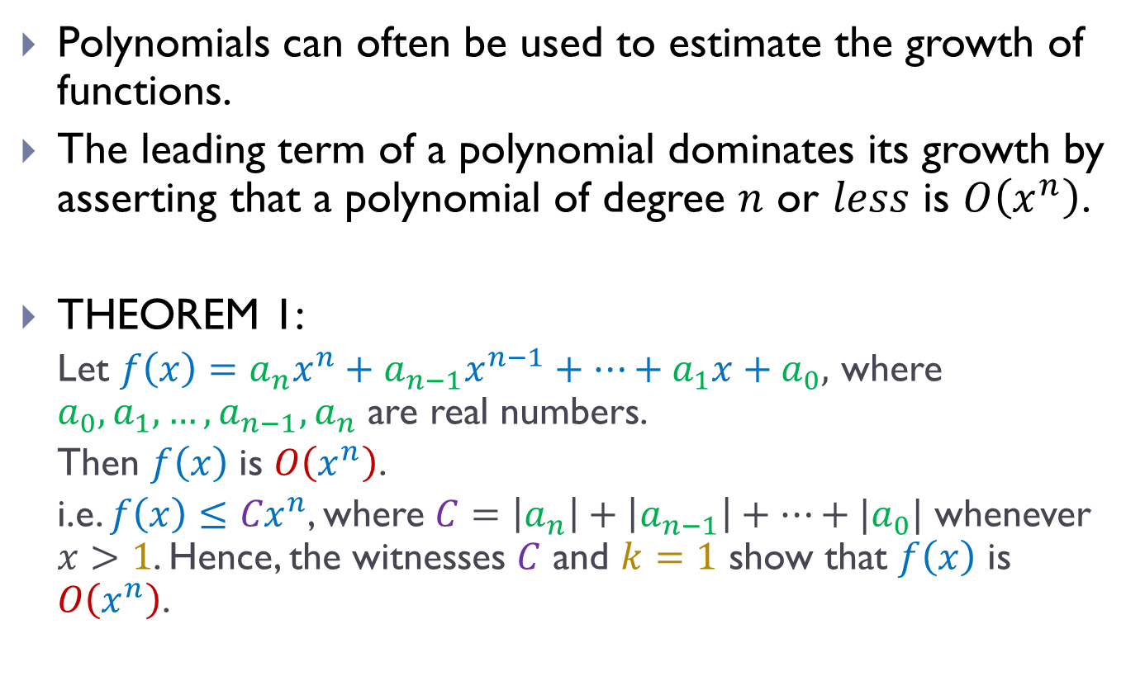
big-O Estimates of Functions
Polynomials can often be used to estimate the growth of functions.
The leading term of a polynomial dominates its growth by asserting that a polynomial of degree $n$ or $less$ is $O\left(x^{n}\right)$.
THEOREM 1:
Let $f\left(x\right)=a_{n}x^{n}+a_{n−1}x^{n−1}+…+a_{1}x+a_{0},$ where $a_{0},a_{1},…,a_{n−1},a_{n}$ are real numbers.
Then $f\left(x\right)$ is $O\left(x^{n}\right)$.
i.e. $f\left(x\right)≤{Cx}^{n}$, where $C=\left|a_{n}\right|+\left|a_{n−1}\right|+…+|a_{0}|$ whenever $x>1$. Hence, the witnesses $C$ and $k=1$ show that $f\left(x\right)$ is $O\left(x^{n}\right)$.

Slide 13
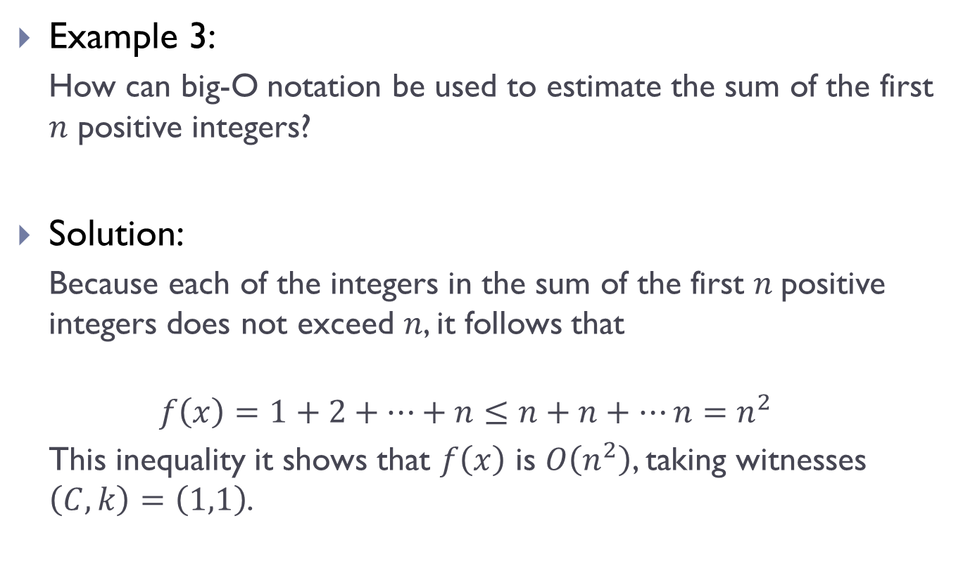
big-O Estimates of Functions (Contd.)
Example 3:
How can big-O notation be used to estimate the sum of the first $n$ positive integers?
Solution:
Because each of the integers in the sum of the first $n$positive integers does not exceed $n$, it follows that
$$f\left(x\right)=1+2+…+n≤n+n+…n=n^{2}$$
This inequality it shows that $f\left(x\right)$ is $O\left(n^{2}\right)$, taking witnesses $\left(C,k\right)=\left(1,1\right)$.

Slide 14

big-O Estimates of Functions (Contd.)
Example 4:
Give big-O estimates for the $factorial function$and the $logarithm of the factorial function$, where the factorial function $f(n) = n!$ is defined by$n! = 1 · 2 · 3 · · · · · n$ whenever $n$ is a positive integer, and $0! = 1$.

Slide 15
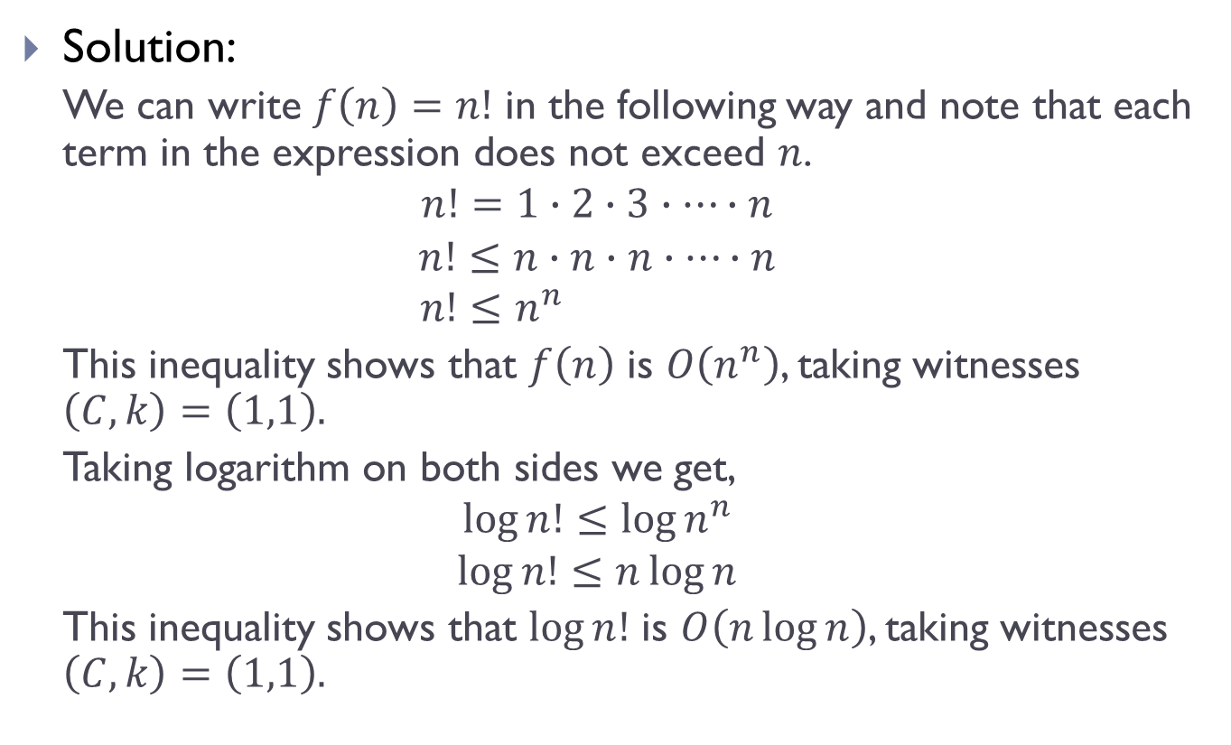
big-O Estimates of Functions (Contd.)
Solution:
We can write $f\left(n\right)=n!$ in the following way and note that each term in the expression does not exceed $n$.
$$n!=1∙2∙3∙…∙n$$
$$n!≤n∙n∙n∙…∙n$$
$$n!≤n^{n}$$
This inequality shows that $f\left(n\right)$ is $O\left(n^{n}\right)$, taking witnesses $\left(C,k\right)=\left(1,1\right).$
Taking logarithm on both sides we get,
$$\log{n!}≤\log{n^{n}}$$
$$\log{n!}≤n\log{n}$$
This inequality shows that $\log{n!}$ is $O\left(n\log{n}\right)$, taking witnesses $\left(C,k\right)=\left(1,1\right).$

Slide 16
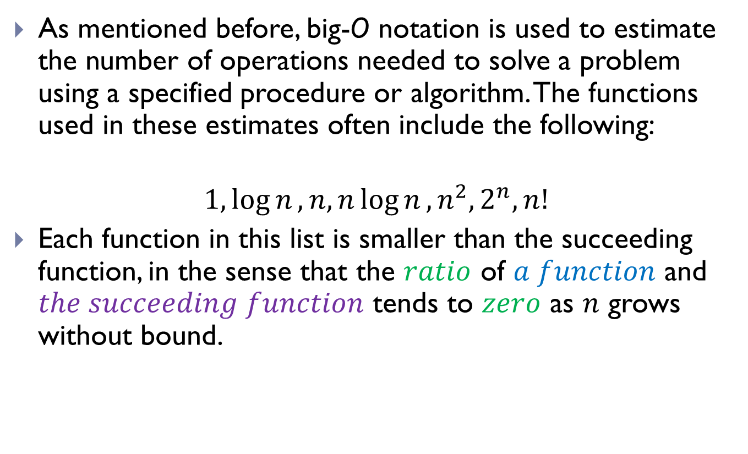
big-O Estimates of Functions (Contd.)
As mentioned before, big-O notation is used to estimate the number of operations needed to solve a problem using a specified procedure or algorithm. The functions used in these estimates often include the following:
$$1,\log{n}, n,n\log{n}, n^{2}, 2^{n},n!$$
Each function in this list is smaller than the succeeding function, in the sense that the $ratio$ of $a function$ and $the succeeding function$ tends to $zero$ as $n$ grows without bound.

Slide 17
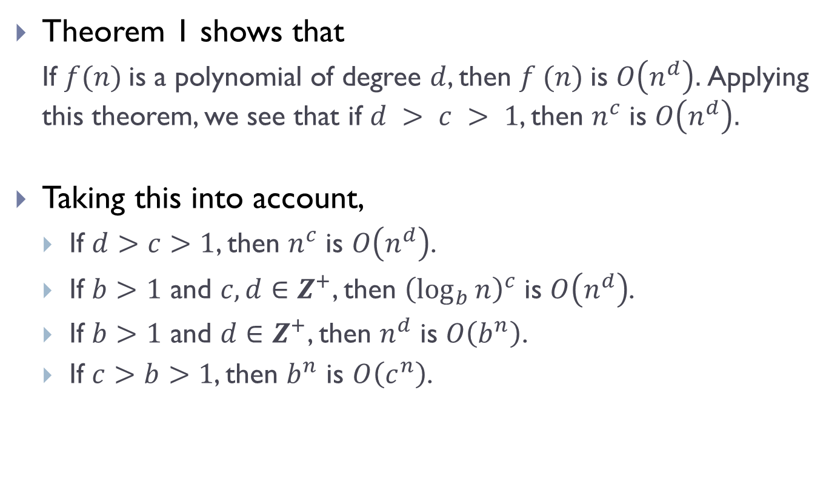
big-O Estimates of Functions (Contd.)
Theorem 1 shows that
If $f(n)$is a polynomial of degree $d$, then $f (n)$is $O\left(n^{d}\right).$Applying this theorem, we see that if $d > c > 1$, then $n^{c}$ is $O\left(n^{d}\right).$
Taking this into account,
If $d>c>1$, then $n^{c}$ is $O\left(n^{d}\right)$.
If $b>1$ and $c, d∈Z^{+}$, then ${\left(\log_{b}{n}\right)}^{c}$ is $O\left(n^{d}\right)$.
If $b>1$ and $d∈Z^{+}$, then $n^{d}$ is $O\left(b^{n}\right)$.
If $c>b>1$, then $b^{n}$ is $O\left(c^{n}\right)$.

Slide 18
Growth of Combination of Functions
Many algorithms are made up of two or more separate sub-procedures.
To give a big-O estimate for the number of steps needed, it is necessary to,
Find big-O estimates for the number of steps used by each sub-procedure
Combine these estimates.
Big-O estimates of combinations of functions can be provided if care is taken when different big-O estimates are combined. In particular,
Estimate the growth of the sum of two functions.
Estimate the growth of the product of two functions.

Slide 19
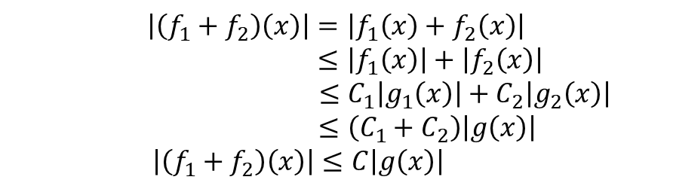
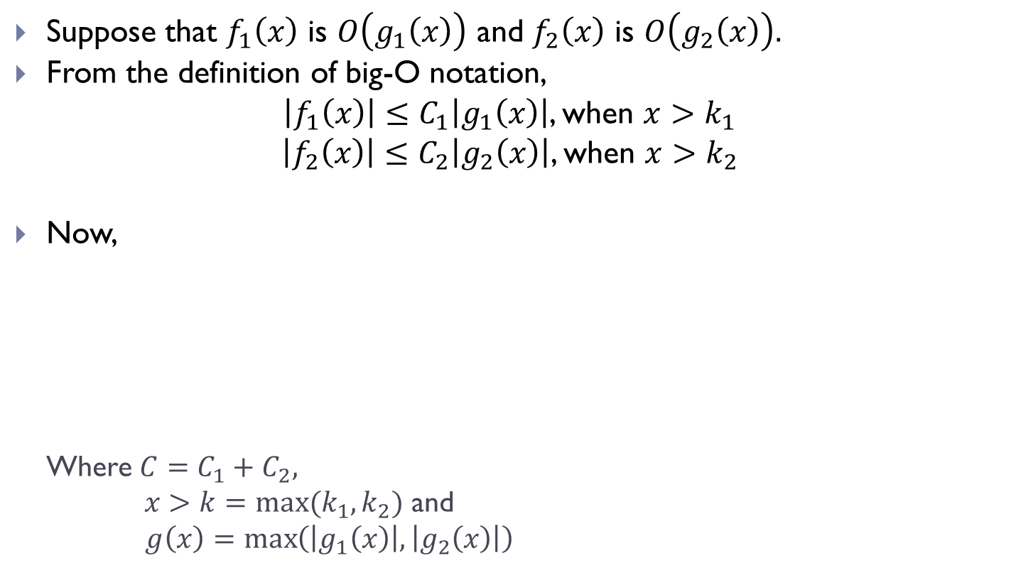
Growth of Combination of Functions(Contd.)
Suppose that $f_{1}\left(x\right)$ is $O\left(g_{1}\left(x\right)\right)$ and $f_{2}\left(x\right)$ is $O\left(g_{2}\left(x\right)\right).$
From the definition of big-O notation,
$\left|f_{1}\left(x\right)\right|≤C_{1}\left|g_{1}\left(x\right)\right|$, when $x>k_{1}$
$\left|f_{2}\left(x\right)\right|≤C_{2}\left|g_{2}\left(x\right)\right|$, when $x>k_{2}$
Now,
Where $C=C_{1}+C_{2},$
$x>k=max⁡(k_{1},k_{2})$ and
$g\left(x\right)=\max\left(\left|g_{1}\left(x\right)\right|, \left|g_{2}\left(x\right)\right|\right)$
$$\left|\left(f_{1}+f_{2}\right)\left(x\right)\right|=\left|f_{1}\left(x\right)+f_{2}\left(x\right)\right|$$ $$≤\left|f_{1}\left(x\right)\right|+\left|f_{2}\left(x\right)\right|$$ $$≤C_{1}\left|g_{1}\left(x\right)\right|+C_{2}\left|g_{2}\left(x\right)\right|$$ $$≤\left(C_{1}+C_{2}\right)\left|g\left(x\right)\right|$$ $$\left|\left(f_{1}+f_{2}\right)\left(x\right)\right|≤C\left|g\left(x\right)\right|$$

Slide 20
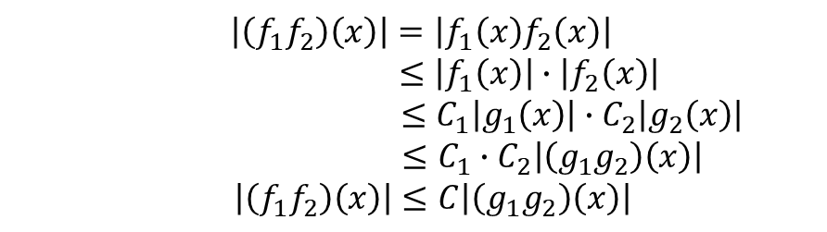
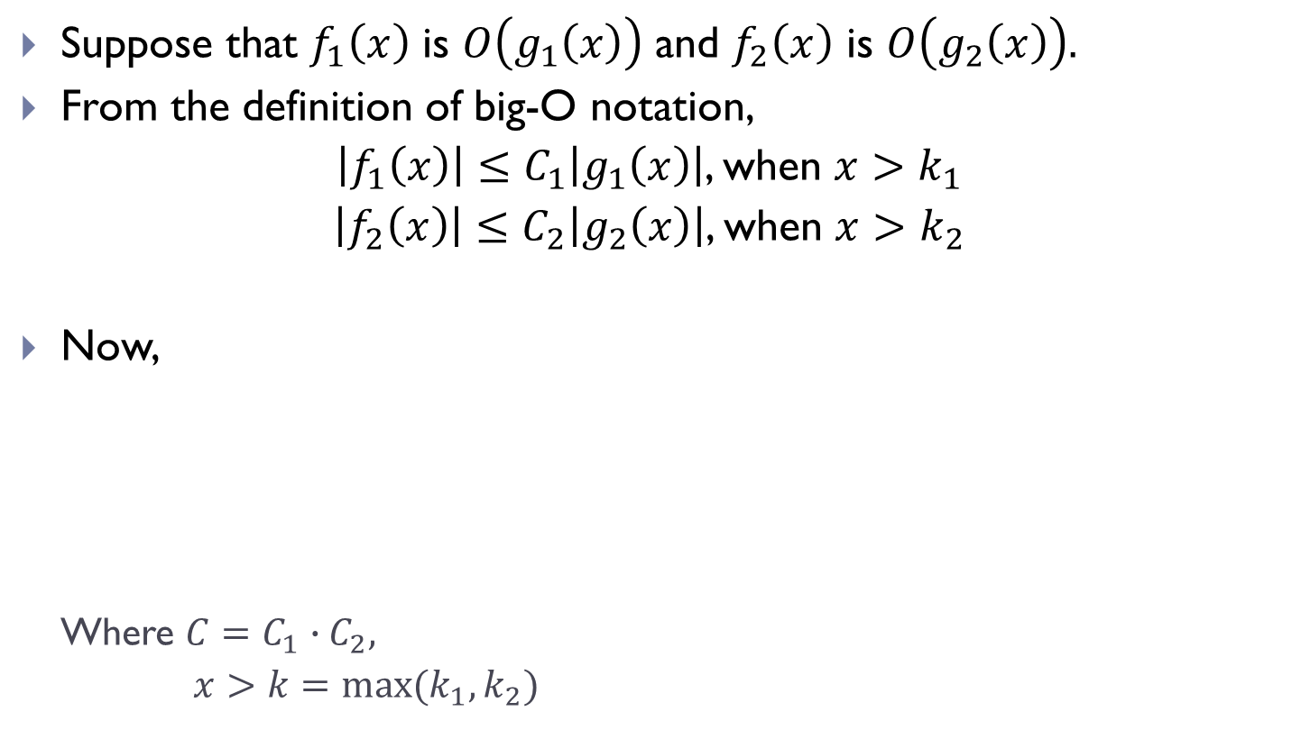
Growth of Combination of Functions(Contd.)
Suppose that $f_{1}\left(x\right)$ is $O\left(g_{1}\left(x\right)\right)$ and $f_{2}\left(x\right)$ is $O\left(g_{2}\left(x\right)\right).$
From the definition of big-O notation,
$\left|f_{1}\left(x\right)\right|≤C_{1}\left|g_{1}\left(x\right)\right|$, when $x>k_{1}$
$\left|f_{2}\left(x\right)\right|≤C_{2}\left|g_{2}\left(x\right)\right|$, when $x>k_{2}$
Now,
Where $C=C_{1}∙C_{2},$
$x>k=max⁡(k_{1},k_{2})$
$$\left|\left(f_{1}f_{2}\right)\left(x\right)\right|=\left|f_{1}\left(x\right)f_{2}\left(x\right)\right|$$ $$≤\left|f_{1}\left(x\right)\right|∙\left|f_{2}\left(x\right)\right|$$ $$≤C_{1}\left|g_{1}\left(x\right)\right|∙C_{2}\left|g_{2}\left(x\right)\right|$$ $$≤C_{1}∙C_{2}\left|\left(g_{1}g_{2}\right)\left(x\right)\right|$$ $$\left|\left(f_{1}f_{2}\right)\left(x\right)\right|≤C\left|\left(g_{1}g_{2}\right)\left(x\right)\right|$$

Slide 21
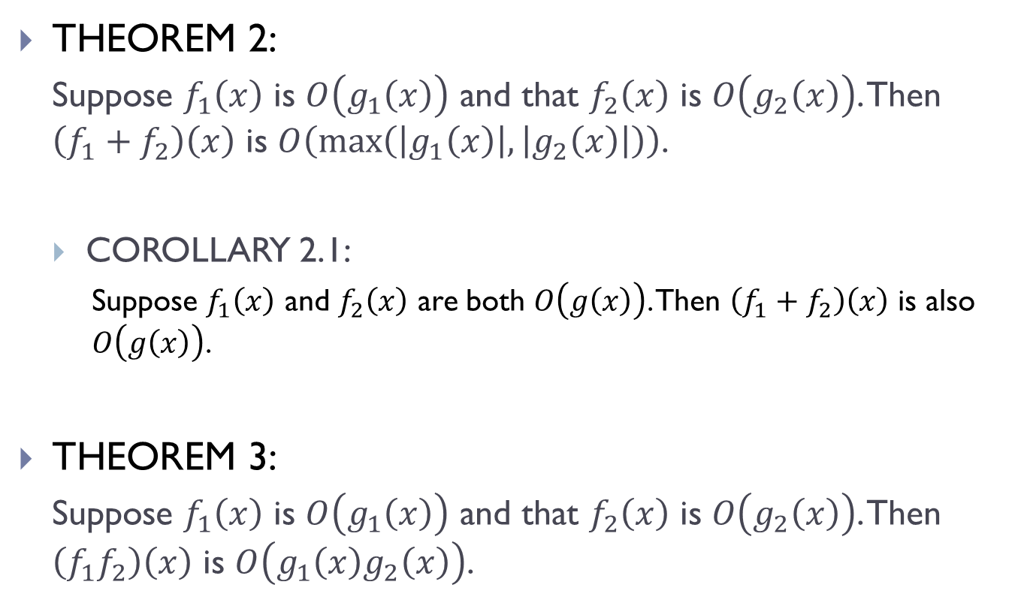
Growth of Combination of Functions(Contd.)
THEOREM 2:
Suppose $f_{1}\left(x\right)$ is $O\left(g_{1}\left(x\right)\right)$ and that $f_{2}\left(x\right)$ is $O\left(g_{2}\left(x\right)\right)$. Then $\left(f_{1}+f_{2}\right)\left(x\right)$ is $O\left(\max\left(\left|g_{1}\left(x\right)\right|, \left|g_{2}\left(x\right)\right|\right)\right)$.
COROLLARY 2.1:
Suppose $f_{1}\left(x\right)$ and $f_{2}\left(x\right)$ are both $O\left(g\left(x\right)\right)$. Then $\left(f_{1}+f_{2}\right)\left(x\right)$ is also $O\left(g\left(x\right)\right)$.
THEOREM 3:
Suppose $f_{1}\left(x\right)$ is $O\left(g_{1}\left(x\right)\right)$ and that $f_{2}\left(x\right)$ is $O\left(g_{2}\left(x\right)\right)$. Then $\left(f_{1}f_{2}\right)\left(x\right)$ is $O\left(g_{1}\left(x\right)g_{2}\left(x\right)\right)$.

Slide 22
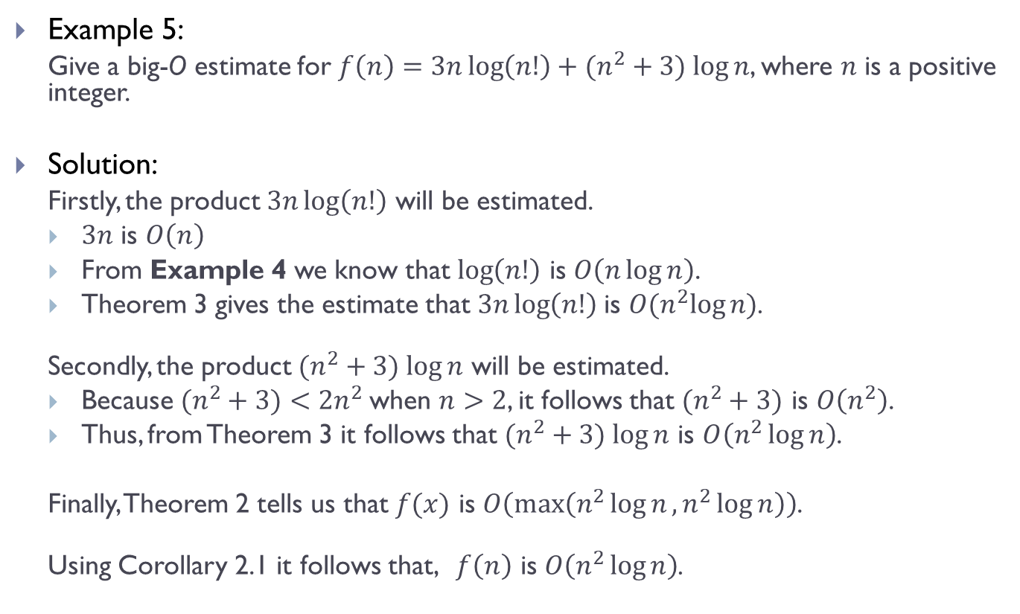
Growth of Combination of Functions(Contd.)
Example 5:
Give a big-O estimate for $f\left(n\right)=3n\log\left(n!\right)+(n^{2}+3) log⁡n$, where $n$ is a positive integer.
Solution:
Firstly, the product $3n\log\left(n!\right)$ will be estimated.
$3n$ is $O\left(n\right)$
From Example 4 we know that $\log\left(n!\right)$ is $O\left(n\log{n}\right)$.
Theorem 3 gives the estimate that $3n\log\left(n!\right)$is $O(n^{2}log⁡n)$.
Secondly, the product $(n^{2}+3) log⁡n$ will be estimated.
Because $(n^{2}+3)<2n^{2}$when $n>2$, it follows that $(n^{2}+3)$ is $O\left(n^{2}\right)$.
Thus, from Theorem 3 it follows that $(n^{2}+3) log⁡n$ is $O\left(n^{2}\log{n}\right)$.
Finally, Theorem 2 tells us that $f(x)$ is $O\left(\max\left(n^{2}\log{n},n^{2}\log{n}\right)\right)$.
Using Corollary 2.1 it follows that, $f\left(n\right)$ is $O\left(n^{2}\log{n}\right)$.

Slide 23
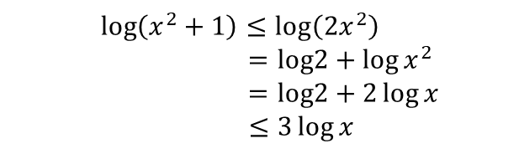
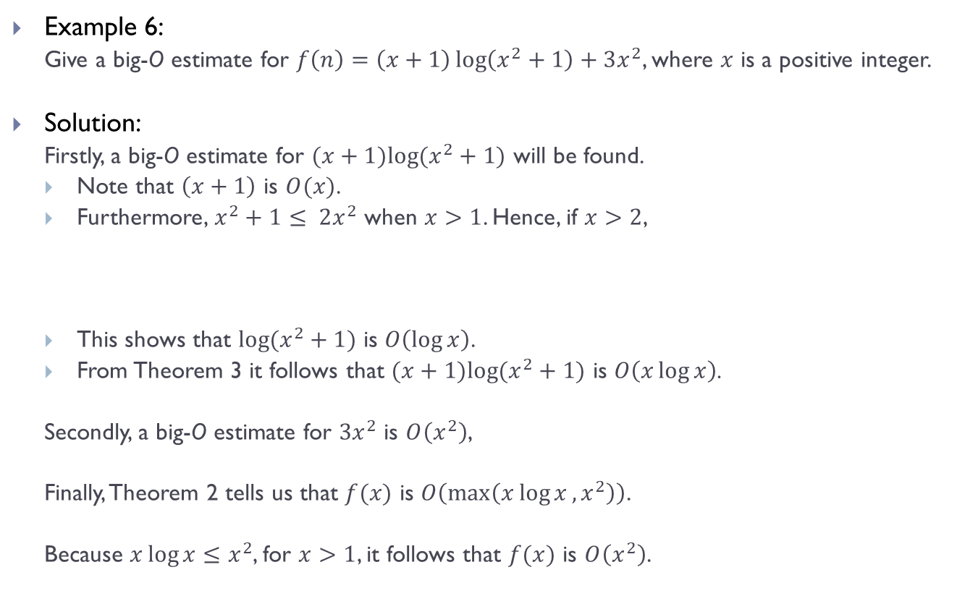
Growth of Combination of Functions(Contd.)
Example 6:
Give a big-O estimate for $f\left(n\right)=\left(x+1\right)\log\left(x^{2}+1\right)+3x^{2}$, where $x$ is a positive integer.
Solution:
Firstly, a big-O estimate for $(x+1)log⁡(x^{2}+1)$ will be found.
Note that $\left(x+1\right)$ is $O(x)$.
Furthermore, $x^{2}+1≤ 2x^{2}$ when $x>1$. Hence, if $x>2$,
This shows that $log⁡(x^{2}+1)$ is $O\left(\log{x}\right)$.
From Theorem 3 it follows that $(x+1)log⁡(x^{2}+1)$ is $O\left(x\log{x}\right)$.
Secondly, a big-O estimate for $3x^{2}$ is $O\left(x^{2}\right)$,
Finally, Theorem 2 tells us that $f(x)$ is $O\left(\max\left(x\log{x}, x^{2}\right)\right)$.
Because $x\log{x}≤x^{2}$, for $x>1$, it follows that $f(x)$ is $O\left(x^{2}\right)$.
$$\log\left(x^{2}+1\right)≤\log\left(2x^{2}\right)$$ $$=log2+\log{x^{2}}$$ $$=log2+2\log{x}$$ $$≤3\log{x}$$

Slide 24
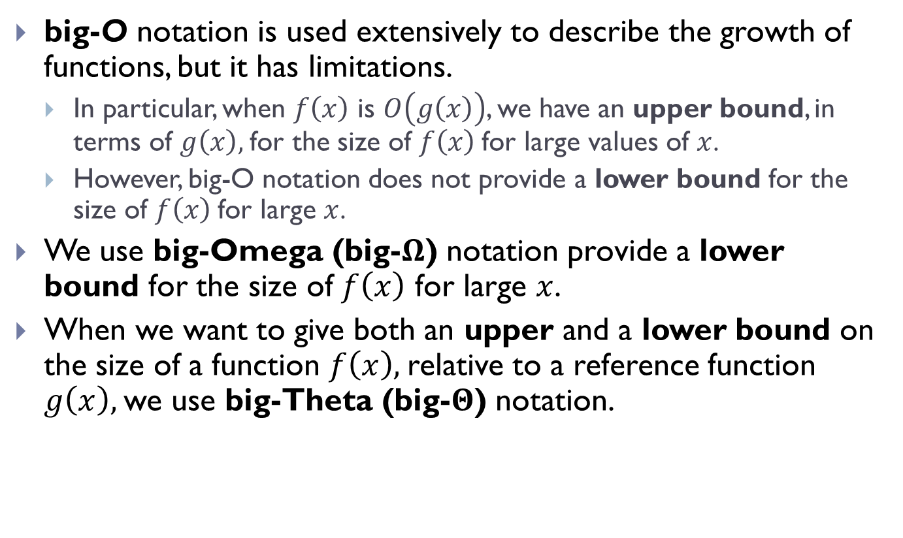
Big-Omega and Big Theta
big-O notation is used extensively to describe the growth of functions, but it has limitations.
In particular, when $f\left(x\right)$ is $O\left(g\left(x\right)\right)$, we have an upper bound, in terms of $g\left(x\right),$for the size of $f\left(x\right)$for large values of $x$.
However, big-O notation does not provide a lower bound for the size of $f\left(x\right)$for large $x$.
We use big-Omega (big-$Ω$) notation provide a lower bound for the size of $f\left(x\right)$ for large $x$.
When we want to give both an upper and a lower bound on the size of a function $f\left(x\right),$relative to a reference function $g\left(x\right),$we use big-Theta (big-$Θ$) notation.

Slide 25
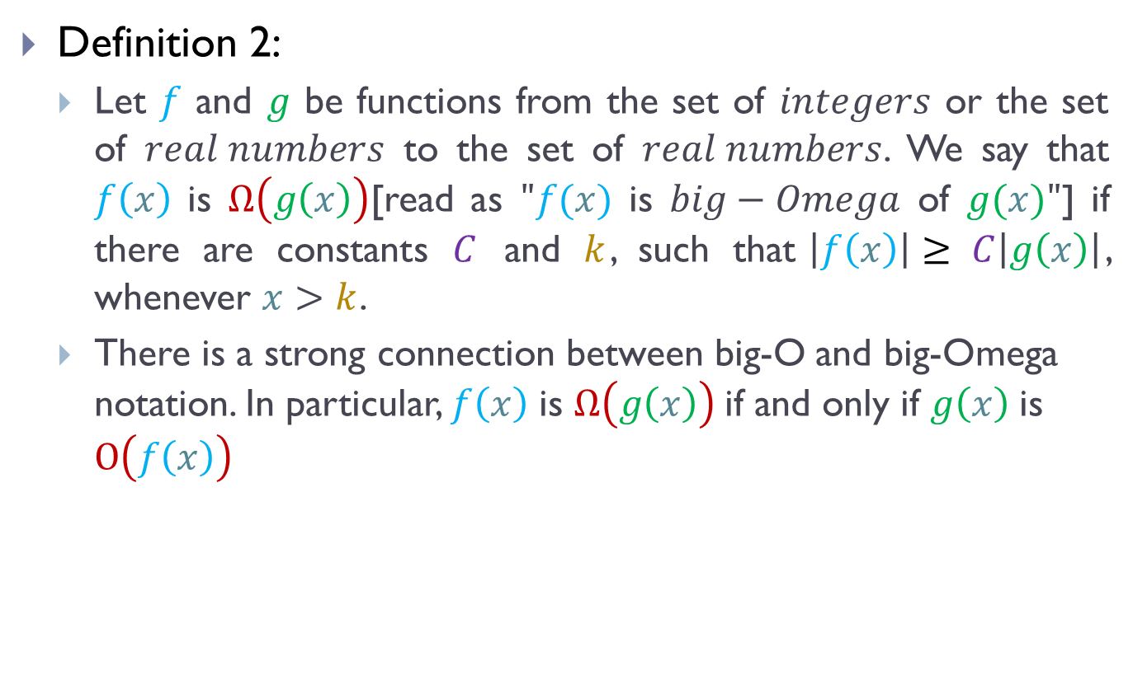
Big-Omega and Big Theta
Definition 2:
Let $f$ and $g$ be functions from the set of $integers$ or the set of $real numbers$ to the set of $real numbers$. We say that $f\left(x\right)$ is $Ω\left(g\left(x\right)\right)$[read as $"f(x)$ is $big−Omega$ of $g(x)"$] if there are constants $C$ and $k$, such that$\left|f\left(x\right)\right|≥ C\left|g\left(x\right)\right|$, whenever $x>k$.
There is a strong connection between big-O and big-Omega notation. In particular, $f\left(x\right)$ is $Ω\left(g\left(x\right)\right)$if and only if $g\left(x\right)$is $O\left(f\left(x\right)\right)$

Slide 26
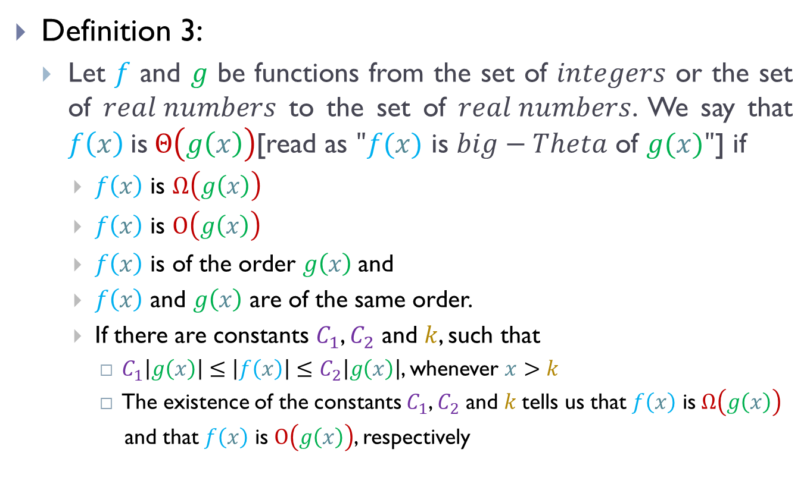
Big-Omega and Big Theta
Definition 3:
Let $f$ and $g$ be functions from the set of $integers$ or the set of $real numbers$ to the set of $real numbers$. We say that $f\left(x\right)$is$Θ\left(g\left(x\right)\right)$[read as $"f(x)$ is $big−Theta$ of $g(x)"$] if
$f\left(x\right)$ is $Ω\left(g\left(x\right)\right)$
$f\left(x\right)$ is $O\left(g\left(x\right)\right)$
$f\left(x\right)$ is of the order $g\left(x\right)$and
$f\left(x\right)$ and $g\left(x\right)$ are of the same order.
If there are constants $C_{1}$, $C_{2}$ and $k$, such that
$C_{1}\left|g\left(x\right)\right|≤\left|f\left(x\right)\right|≤C_{2}\left|g\left(x\right)\right|$, whenever $x>k$
The existence of the constants $C_{1}$, $C_{2}$ and $k$tells us that $f\left(x\right)$ is$Ω\left(g\left(x\right)\right)$
and that $f\left(x\right)$ is $O\left(g\left(x\right)\right)$, respectively

Slide 27
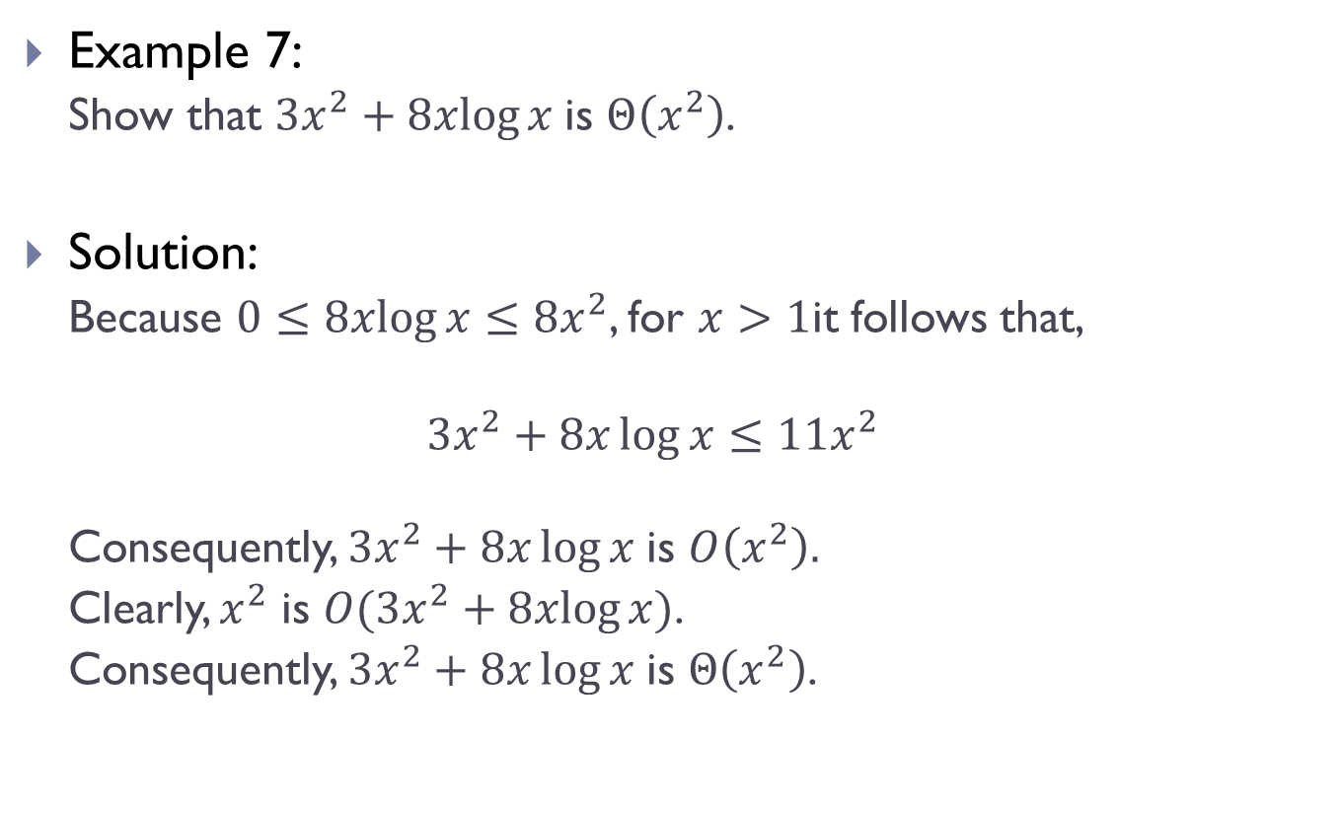
Big-Omega and Big Theta
Example 7:
Show that $3x^{2}+8xlog⁡x$is $Θ\left(x^{2}\right)$.
Solution:
Because $0≤8xlog⁡x≤8x^{2}$, for $x>1$it follows that,
$$3x^{2}+8x\log{x}≤11x^{2}$$
Consequently, $3x^{2}+8x\log{x}$is $O\left(x^{2}\right).$
Clearly, $x^{2}$ is $O(3x^{2}+8xlog⁡x)$.
Consequently, $3x^{2}+8x\log{x}$is $Θ\left(x^{2}\right)$.

Slide 28
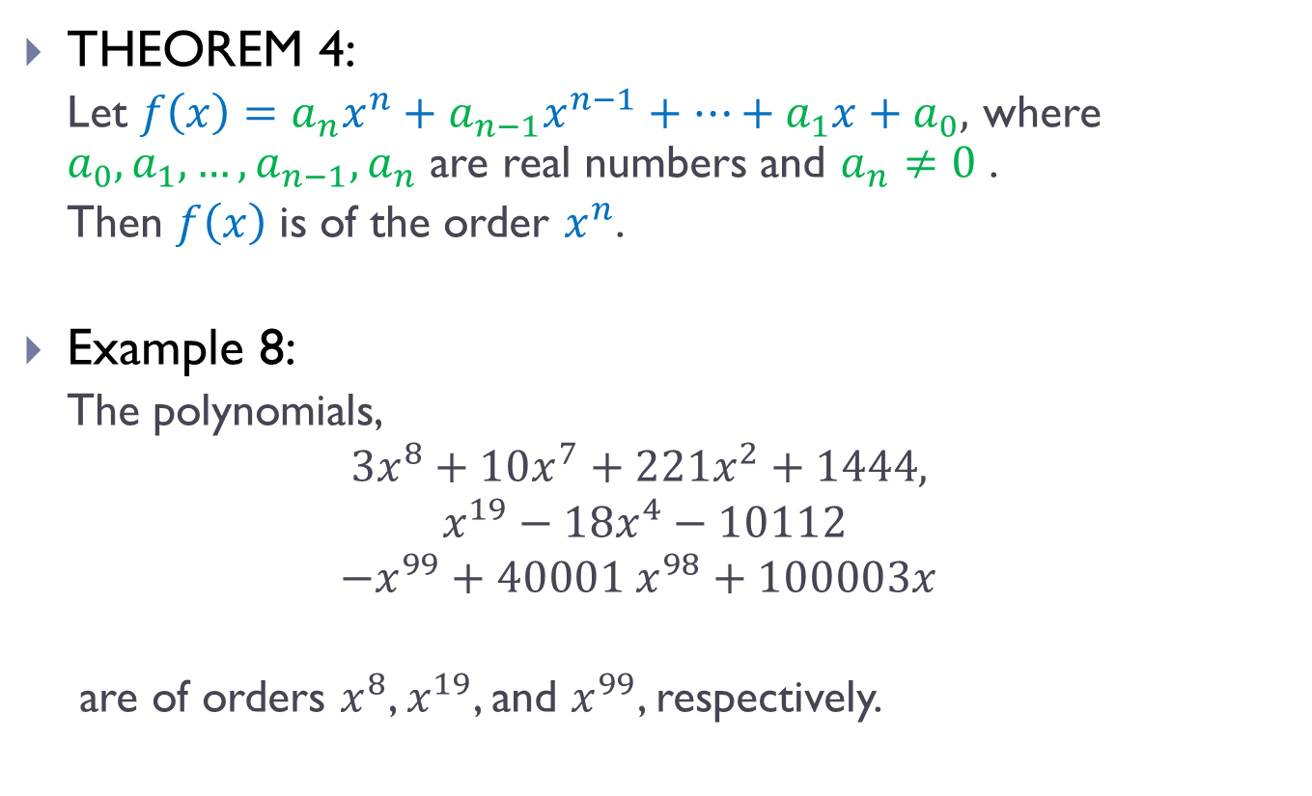
Big-Omega and Big Theta
THEOREM 4:
Let $f\left(x\right)=a_{n}x^{n}+a_{n−1}x^{n−1}+…+a_{1}x+a_{0},$ where $a_{0},a_{1},…,a_{n−1},a_{n}$ are real numbers and $a_{n}≠0$ .
Then $f\left(x\right)$ is of the order $x^{n}$.
Example 8:
The polynomials,
$$3x^{8}+10x^{7}+221x^{2}+1444,$$
$$x^{19}−18x^{4}−10112$$
$$−x^{99}+40001 x^{98}+100003x$$
are of orders $x^{8}$, $x^{19}$, and $x^{99}$, respectively.

Slide 29
THE END

